Slide 1
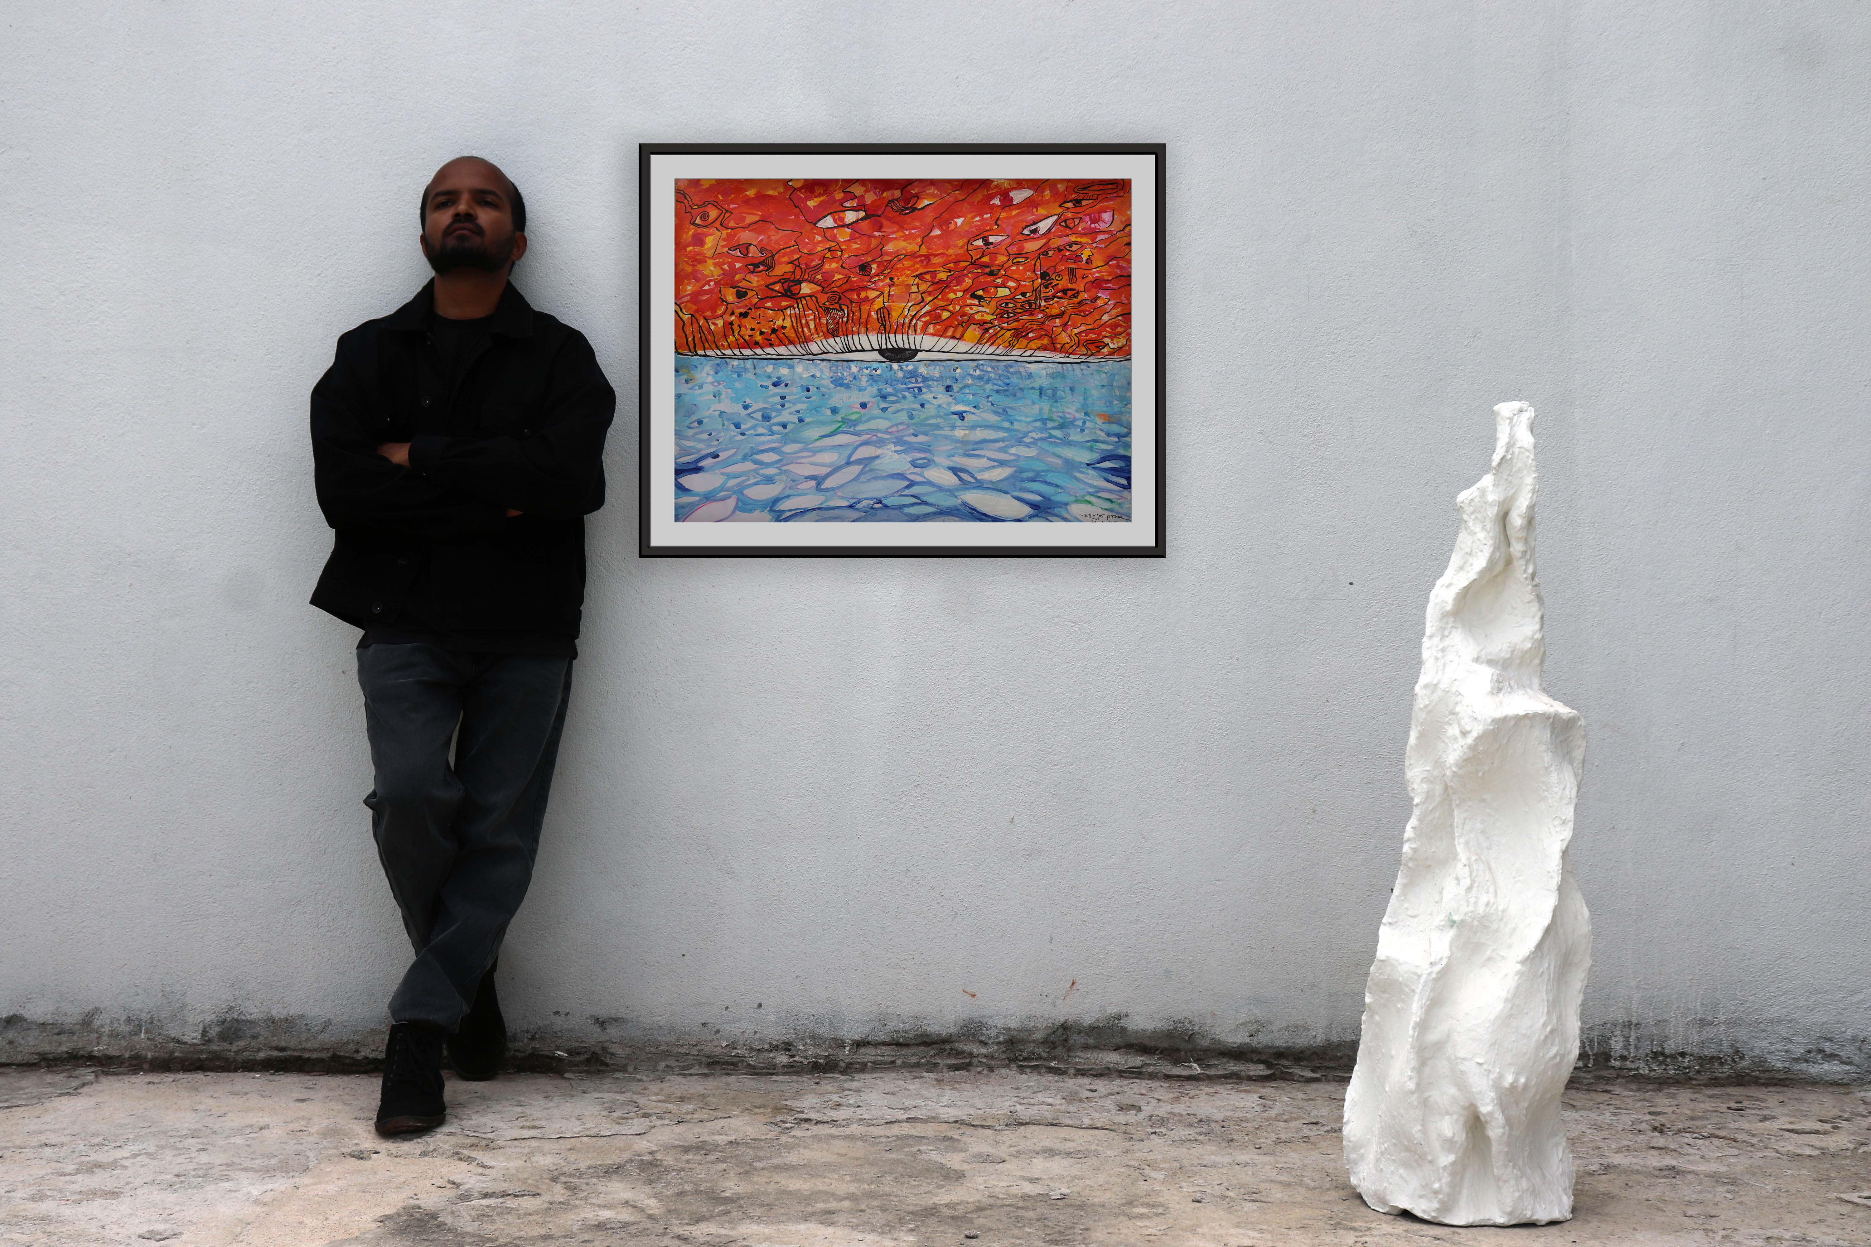

THE BURDEN OF GOODNESS
Series: Duality1/5
Medium: Acrylic on Ivory paper
Size: 56cm x 71cm
Price: ₹250000 INR
-: click for artwork process :-
The Burden of Goodness is a contemplative exploration of morality, pleasure, pain, and the subtle identities we create around them.
The upper half represents goodness and pleasure—the part of us that knows what it wants and moves toward it. The eyes have pupils, symbolising awareness, direction, and desire. Yet every desire can carry its own attachments: fear, anger, jealousy, pride, and the fear of losing what we seek.
The lower half represents pain, struggle, and surrender. The eyes have no pupils, suggesting a state that does not seek or grasp. Through struggle, sacrifice, and stepping beyond comfort, attachments can begin to dissolve.
At the centre is the open eye of consciousness—awareness beyond the labels of good and bad, pleasure and pain.
The partially closing eyelid becomes the final metaphor. The path from above is obstructed, while below it remains open. It suggests that even the identity of being good, or the desire for a higher state of awareness, can become another form of attachment.
The painting ultimately asks: Who are you beyond the need to be good, bad, right, or wrong?
And perhaps, more subtly: Can awakening be found when there is nothing left to seek?

